Slide 1
Color Correction for Digital Photographs
Proceedings of the 12th International Conference on Image Analysis and Processing 2003 IEEE

Slide 2
The algorithm is structured in two parts
I. cast detector
II. cast remover

Slide 3
I. cast detector
The detector classifies the input images as:
no cast: preserve
intrinsic cast: preserve
evident cast: remove
ambiguous cast: remove

Slide 4
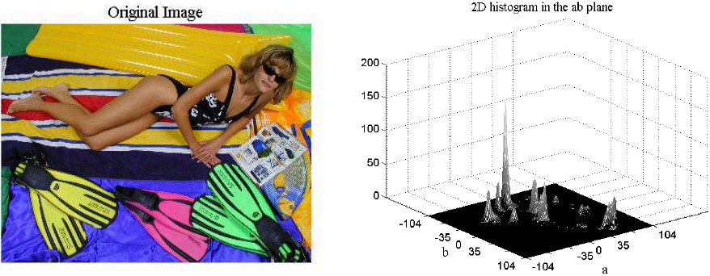
A multicolor image without cast
produces several peaks in the 2D histogram in the ab plane

Slide 5
The color gamut of the image is first mapped in the CIELab color space, where the chromatic components and lightness are separate( RGB -> L*a*b*)
for a multicolor image without cast this histogram will show several peaks distributed over the whole ab plane
for a single color image, it will present a single peak, or few peaks in a limited region

Slide 6
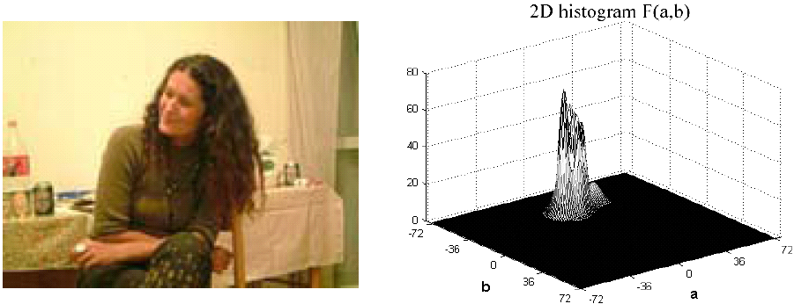
A cast image
produces a concentrated 2D histogram in the ab-plane

Slide 7
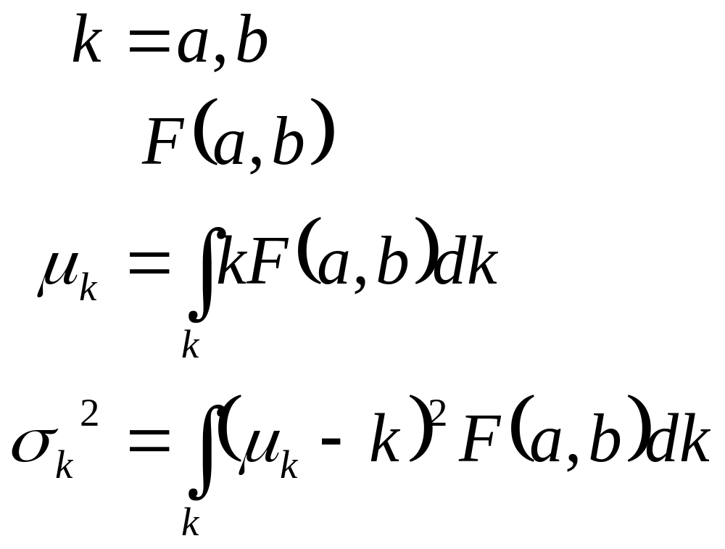
To study the histogram distribution
the intensity
the mean values
the variances

Slide 8
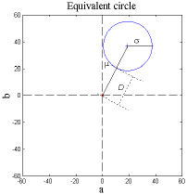
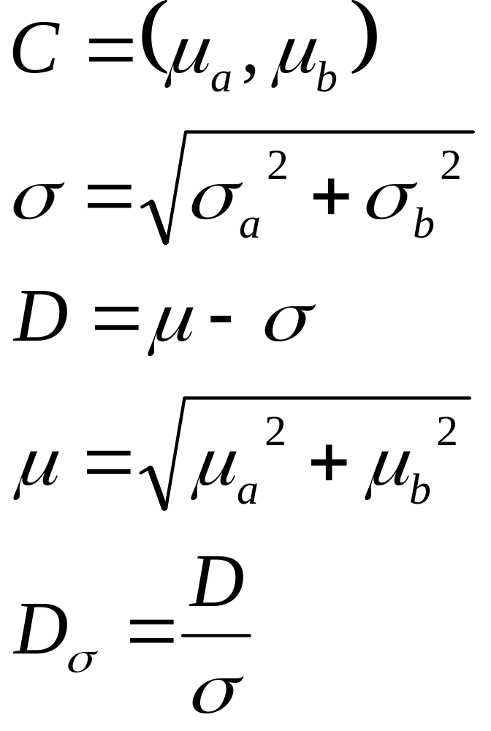
Equivalent Circle

Slide 9
Cast detector rule
unclassifiable: 30 < L* < 95, if the considered portion is less than 20% of the whole. These are not processed.
either an evident cast, or a predominant cast:
( D > 10 and D_{σ} > 0.6 ) or ( D_{σ} > 1.5 )
If sky, skin, sea or vegetation covers over 40% of the whole image; the image is classified as having an intrinsic cast
greater Dσ, the stronger cast

Slide 10
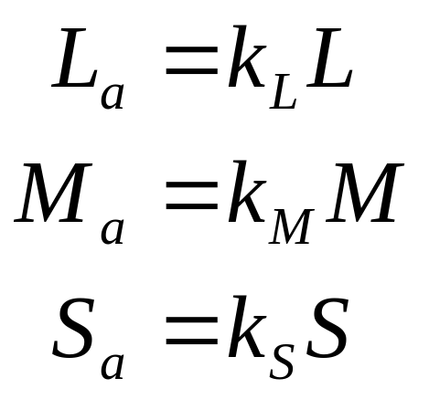
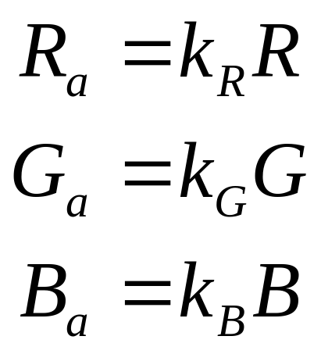
II. cast remover
eyeball
chromatic adaptation
Von Kries Hypothesis
chromatic adaptation model
DSC
L, M, S: initial cone responses
k_{L}, k_{M}, k_{S}: gain coefficients
L_{a}, M_{a}, S_{a}: post-adaptation responses
R, G, B: initial raw data
k_{R}, k_{G}, k_{B}: white depth
R_{a}, G_{a}, B_{a}: post-adaptation data

Slide 11
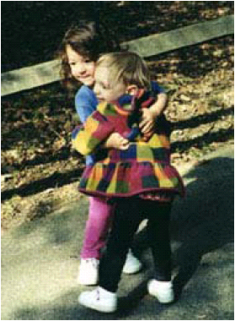
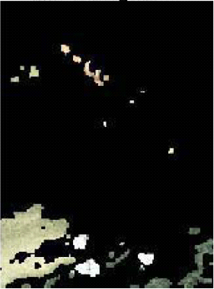
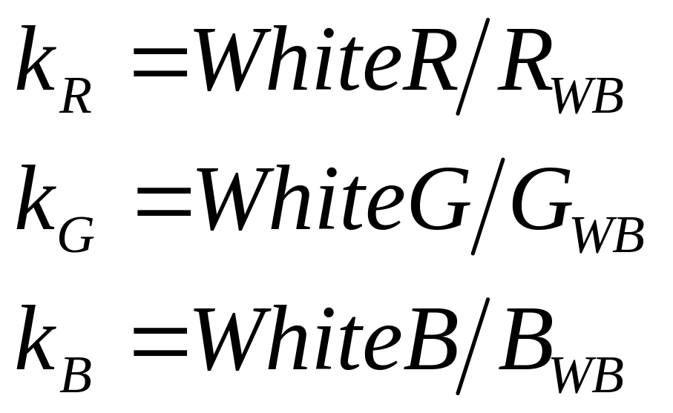
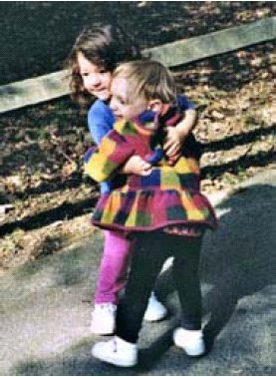
WB region and color correction for a cast image
Original
WB region
k_{R}, k_{G}, k_{B}: white depth
R_{WB},G_{WB},B_{WB}: average of RGB over whole WB area
WhiteR,WhiteG,WhiteB: the reference white
Evident cast: WB region is all significant color peaks in ab histogram and lightness greater than 30
Ambiguous cast: WB region is composed of the NNO of the analyzed portion
Color corrected

Slide 12
NNO

Slide 13
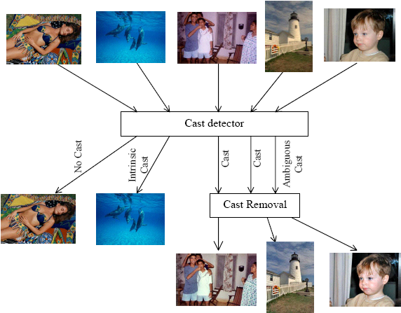
Input and output images processed by cast remover

Slide 14
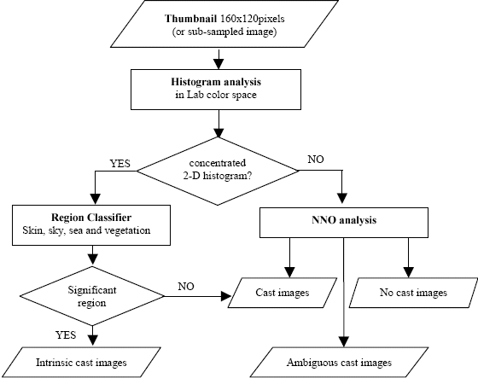
Flow chart of cast detector and cast remove
D_{σ}>0.5
D_{σ}<-0.5
Skin, sky, sea and vegetation
-0.5<D_{σ}<0.5

Slide 15
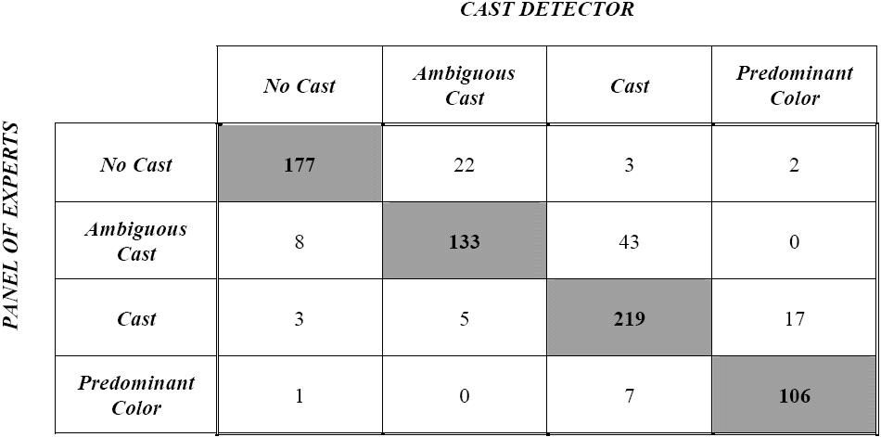
Experiment result by 746 images

Slide 16
Defect

Slide 17
CIELAB

Slide 18
Reference
F. Gasparini, R. Schettini, “Color Correction for Digital Photographs”, IEEE Proc. of the 12th International Conference on Image Analysis and Processing (ICIAP’03),pp. 646-651, 2003

